Slide 1

Employer Group Retiree Program
ASBSD
Tyler Elliott, Group Medicare Consultant
Notes:
Hello!. I appreciate you taking time our of your day to learn a little bit about our Employer Group Retiree Program.
What is EGRP? It is a group sponsored plan that pays secondary to Medicare. These plans look and pay like a Medicare Supplement but are not regulated by the State Insurance Division like Medicare Supplements. They are not true Medicare Supplement plans as they are not standardized and regulated by CMS.

Slide 2

What is Medicare?
Medicare is the federal health insurance program administered by the Centers for Medicare & Medicaid Services (CMS) for people 65 or older. Those with a disability, end-stage renal disease or ALS may be eligible to get Medicare sooner.

Slide 3





Medicare coverage options
ORIGINAL MEDICARE
Medicare Part A: Hospital coverage
Medicare Part B: Medical coverage
ADDITONAL COVERAGE OPTIONS to help cover what Original Medicare doesn’t provide
+
Medicare Part D: Prescription drugs
Medicare Part C (Medicare Advantage): Combines Part A, Part B, and often Part D coverage into one plan. Plans often include valuable extras like dental, vision and hearing
Medicare supplement insurance (Medigap): Helps pay some out-of-pocket costs not paid by Original Medicare

Slide 4
Group Retiree Program
Attributes and Eligibility

Slide 5
Employer group retiree program
Our Employer Group Retiree Program, known as an EGRP is a type of health plan offered to employers for their retiree population.
Currently we offer Program F, G, N and
High Deductible Program F in our EGRP portfolio.
Similar benefits
to individual Medicare supplement plans, making group transition easier
National plan allows retirees to live anywhere and have EGRP coverage
No MACRA impact,
allowing Wellmark to offer a Plan F look-a-like program
Group size matters
in terms of who can be offered these plans — active versus retirees
One plan & rate
for all retirees, not based on age, can be billed to either the group or member
Additional coverage
is available to cover prescription drug coverage and specialty benefits

Slide 6

Other Key Attributes
No underwriting
Automatically renews
Minimal employer admin
Direct carrier contacts
Notes:
Group determines eligibility
Group may pay full premium for retirees. In this case Wellmark will bill the group directly or you can require the retiree to pay the full premium. In this case Wellmark will bill the retiree directly.
We can also class it out as well, meaning you can have 2 different billing units. You can choose to pay for some of the employees.

Slide 7
ASBSD Retiree Program F
How does it work?
Medicare will pay its share of care received.
EGRP Program F policy pays its share.
Members pay any remaining amount not covered by Original Medicare or your Retiree Program F
Who is eligible to enroll in Retiree Program F?
Must be retired and enrolled in Medicare Part A and Part B
Must continue to pay Medicare premiums
Any retiree that has been on the ASBSD health plan, may return to the Retiree Program F
Notes:
Review slide

Slide 8
Group Retiree Program F Coverage and Resources

Slide 9
Employer group retiree program benefits
 | Plan N | Plan G | HD Plan F | Plan F
Basic benefits |  |  |  | 
Skilled nursing facility coinsurance |  |  |  | 
Part A deductible |  |  |  | 
Part B deductible |  |  |  | 
Part B excess charge |  |  |  | 
Foreign travel emergency |  |  |  | 
Plan deductible |  |  | 
MedicareBlueSM Supplement is a service mark of the Blue Cross and Blue Shield Association.​
Notes:
EGRP plans mimic individual Medicare Supplement plans. Highlighted in pink are plans that are no longer offered to those turning 65 after 2020, but because those rules don’t apply to EGRPs they are still available to those newly aging in. Part B deductible is $226.

Slide 10
Employer Group Retiree Program F
 | Program F
BASIC BENEFITS This includes hospitalization, medical expenses, blood and hospice care | ✓
SKILLED NURSING FACILITY COINSURANCE Without this coverage, members are partially responsible for their stay in a skilled nursing facility. | ✓
HOSPITAL (PART A) DEDUCTIBLE Coverage to pay the hospital deductible (an amount set by Medicare) | ✓
MEDICAL (PART B) DEDUCTIBLE This amount will be applied to medical costs. | ✓
MEDICAL (PART B) EXCESS Coverage when a provider charges over the Medicare-approved amount. | ✓
FOREIGN TRAVEL EMERGENCY Coverage when emergency care outside the United States is needed. | ✓
Notes:
UNI offers the Employer Group Retiree Program F. This plan is considered a premium only plan, meaning that once you pay the premium, you will pay nothing further. Program F will pay the remaining balance for expenses covered by Medicare.
If you have researched individual medicare supplement policies, Program F offers the same coverage as Plan F in the individual market. Effective January 1, 2020 there was a federal law passed that for individuals aging into Medicare after January 1st 2020, individual Plan F would not be available for purchase. The good news is that this does not impact the Program F that UNI has available to you….it will remain available to you regardless of when you age into Medicare.

Slide 11
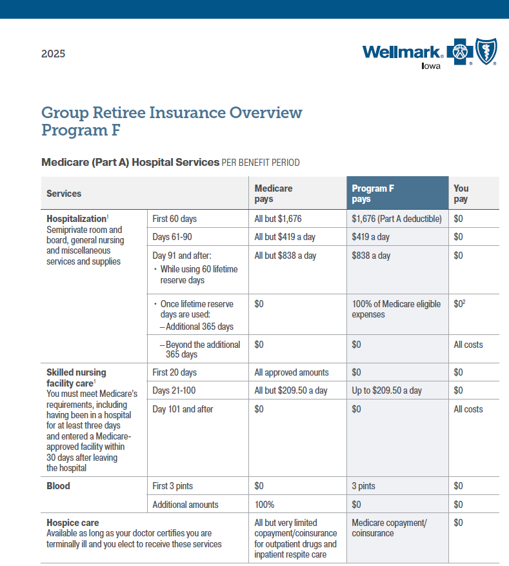
ASBSD Program F 2026 Premium: $262.20

Slide 12




Buy-up options
MedicareBlueSM Rx
(Part D Prescription Drug)
Blue DentalSM
Avēsis® Vision with
AmplifonTM Hearing
Notes:
Wellmark monitors prior year plan performance, claims data, and benefit design appeal with buyers to determine the appropriate plan design for the next year. In keeping with our goal to offer simplified and transparent plan offerings there are minimal changes.
Let's review the plan change document in your folder to help you understand the changes for discussions with your groups.
Iowa

Slide 13
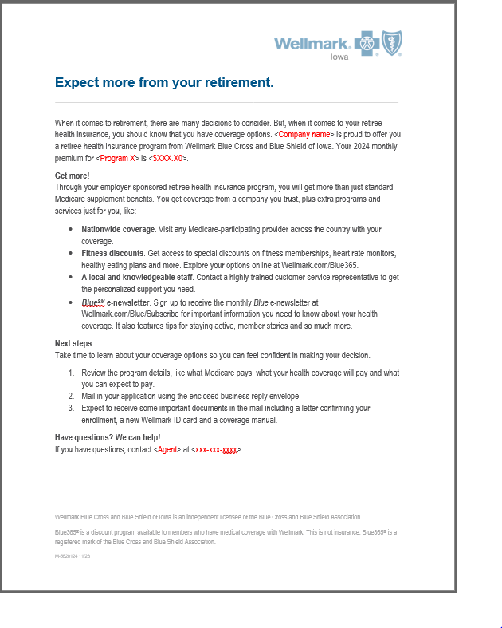
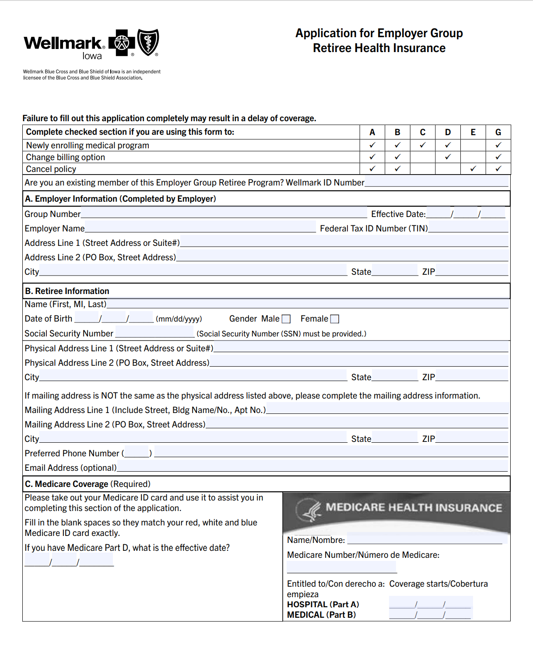
Plan Materials
Employer Group Retiree Program Welcome letter
Employer Group Retiree Program Application
Notes:
Once group is implemented I send out packets to the group contact which include a Welcome Letter, applications and Medicare brochures. The group contact would hand this out to the Employee at retirement, they fill out the application and returns I directly to Wellmark. The group would be very hands off, with little administrative duties.

Slide 14
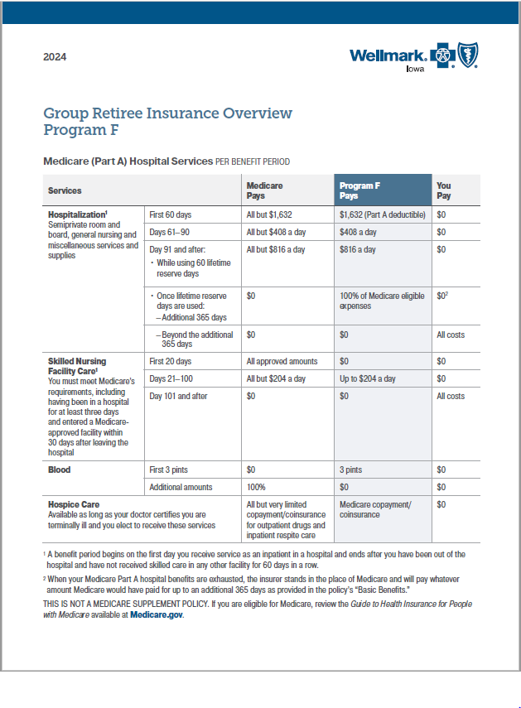
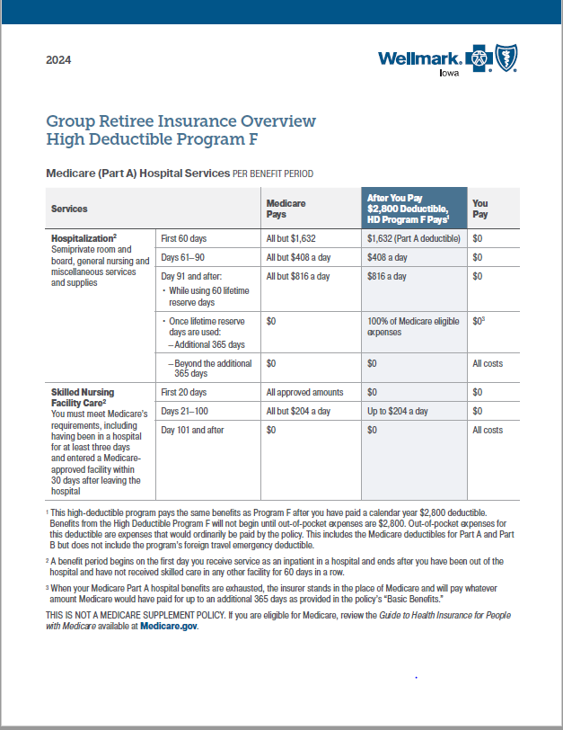
Program Overviews

Slide 15

Medicare Get Ready Guide

Slide 16

Enrolling in the Retiree Program F
Email applications to Wellmark:
Medicarebussinessteam@wellmark.com

Slide 17
Thank you!

